Slide 1
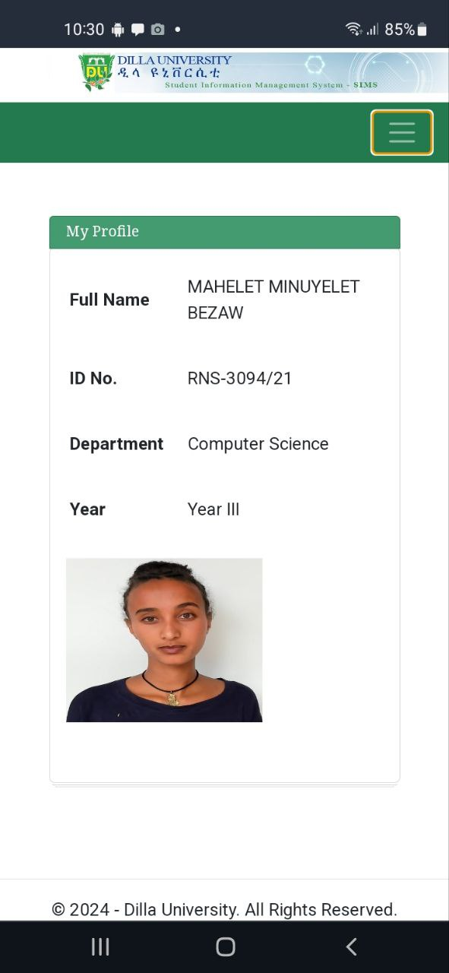

Slide 2
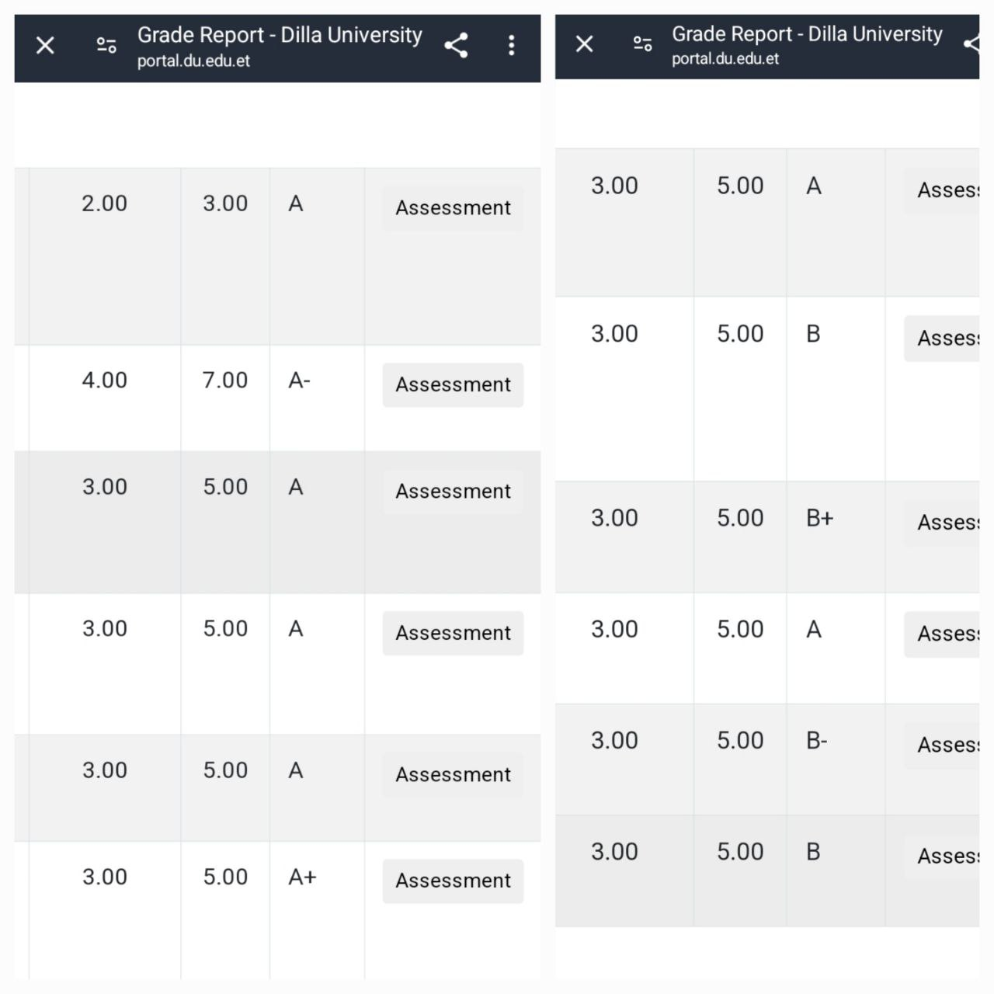

Slide 3


Slide 4
MY DREAM
TO BECOME ONE OF THE BEST UI DESIGNER
I WANT A BETTER EDUCATION
I AM HERE FOR MY FAMILY
TO BE PROUD
BETTER LIFE
BEAUTIFULL FAMILY
PROUD MYSELLF AND FAMILY

